Slide 1
CSC4-I: Continuous Vuln. Assessment & Remediation

Slide 2
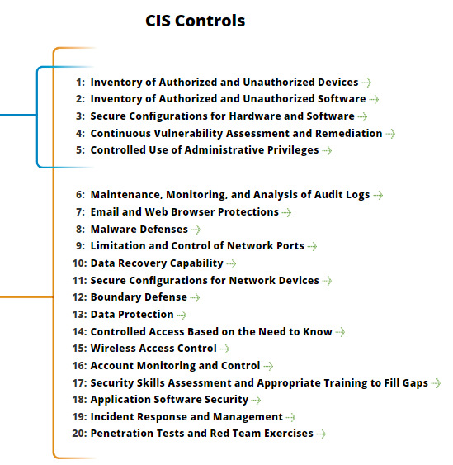
CSC4-I: Continuous Vuln. Assessment & Remediation
https://www.cisecurity.org/controls/

Slide 3
CSC4-I: Continuous Vuln. Assessment & Remediation
4.1: Run automated vulnerability scanning tools against all systems on the network on a weekly or more frequent basis and deliver prioritized lists of the most critical vulnerabilities to each responsible system administrator…

Slide 4
CSC4-I: Continuous Vuln. Assessment & Remediation
4.1…: along with risk scores that compare the effectiveness of system administrators and departments in reducing risk.

Slide 5
CSC4-I: Continuous Vuln. Assessment & Remediation
4.1…: Use a SCAP-validated vulnerability scanner that looks for both code-based vulnerabilities (such as those described by Common

Slide 6
CSC4-I: Continuous Vuln. Assessment & Remediation
Vulnerabilities and Exposures entries) and configuration-based vulnerabilities (as enumerated by the Common Configuration Enumeration Project).

Slide 7
CSC4-I: Continuous Vuln. Assessment & Remediation
4.2: Correlate event logs with information from vulnerability scans to fulfill two goals.
First, personnel should verify that the activity of the regular vulnerability scanning tools is itself logged.

Slide 8
CSC4-I: Continuous Vuln. Assessment & Remediation
4.2…: Second, personnel should be able to correlate attack detection events with prior vulnerability scanning results to determine whether the given exploit was used against a target known to be vulnerable.

Slide 9
CSC4-I: Continuous Vuln. Assessment & Remediation
4.3: Perform vulnerability scanning in authenticated mode either with agents running locally on each end system to analyze the security configuration or with remote scanners that are given administrative rights on the system being tested.

Slide 10
CSC4-I: Continuous Vuln. Assessment & Remediation
4.3…: Use a dedicated account for authenticated vulnerability scans, which should not be used for any other administrative activities and should be tied to specific machines at specific IP addresses.

Slide 11
CSC4-I: Continuous Vuln. Assessment & Remediation
4.3…: Ensure that only authorized employees have access to the vulnerability management user interface and that roles are applied to each user

Slide 12
CSC4-I: Continuous Vuln. Assessment & Remediation
4.4: Subscribe to vulnerability intelligence services in order to stay aware of emerging exposures, and use the information gained from this subscription to update the organization’s vulnerability scanning activities on at least a monthly basis.

Slide 13
CSC4-I: Continuous Vuln. Assessment & Remediation
4.4…: Alternatively, ensure that the vulnerability scanning tools you use are regularly updated with all relevant important security vulnerabilities.
END

